Slide 1

Computer Programming for Engineers
Week 14 Lecture 1
Nov. 29, 2022
Lecturer: Dr. Mohammad Mahdi Javidan
College of Engineering, Sungkyunkwan University
Fall Semester 2022

Slide 2
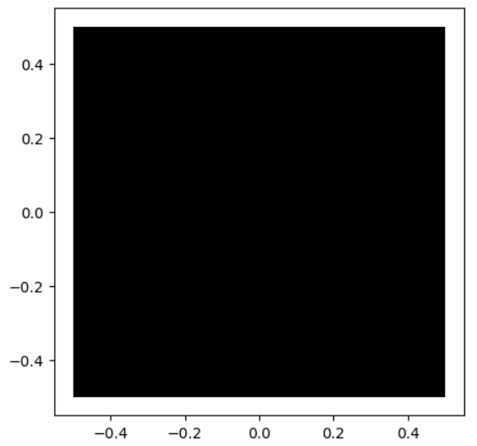
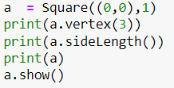

Problem 7
Make the class Square which defines a square as depicted below.
The object Square receives a tuple C which is the coordinates of its center and its side length l and its angle theta. It has a list of tuples __V which is the coordinates of its vertices labeled counterclockwise. Methods are as follows:
vertex(n) gives the coordinates of the nth vertex
side(n) returns the coordinates of the vertices related to the nth side
show(color=‘k’) plots the square with the default black color
__str__() returns the coordinates of vertices as a string
Square
- __C : tuple
- __V : List
Test case
- __init__(C:tuple, l: float)
+ vertex(n): tuple
+ sideLength(): float
+ show(color:str = ‘k’)
- __str__(): str
College of Engineering, Sungkyunkwan University

Slide 3
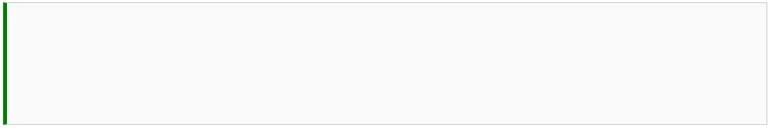
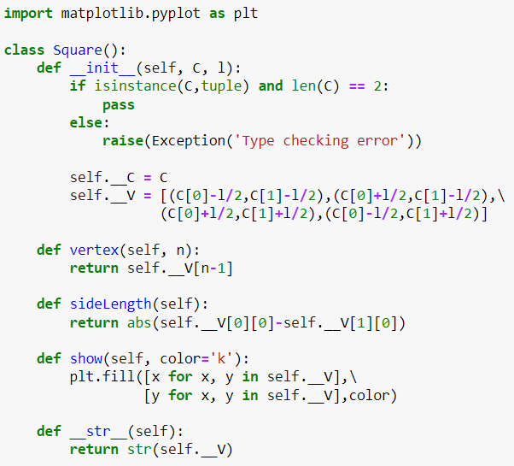
Problem 7
Type checking
Calculating the coordinates of the vertices
Changing the list of tuples to a string
College of Engineering, Sungkyunkwan University

Slide 4
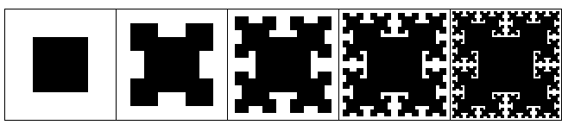





Problem 8
T-square is a fractal which is built upon a square. Squares are recursively placed at convex corners of the previous image as shown below. Write a function T_square(sq, n) which receives a square sq and number of steps n for generating the image.
Test case
$$n=0$$
$$n=1$$
$$n=2$$
$$n=3$$
$$n=4$$
College of Engineering, Sungkyunkwan University

Slide 5
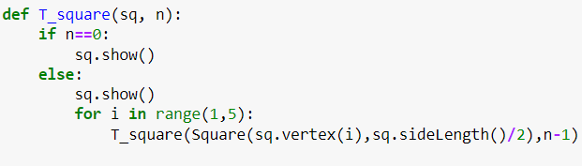
Problem 8
College of Engineering, Sungkyunkwan University

Slide 6
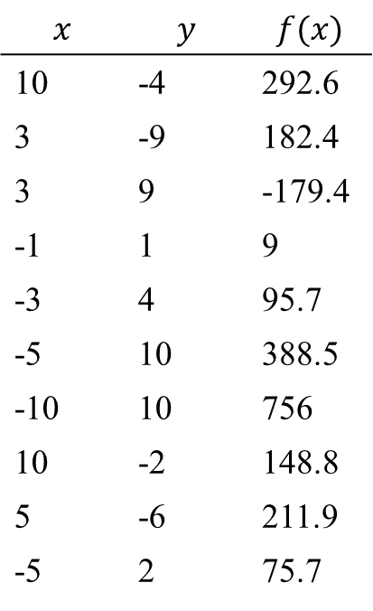
Problem 9
The data given below are theoretically attributed to $f(x,y)=ax+by+cxy$where $a$, $b$, and $c$ are coefficients. Use the curve fitting tool from the scipy package and find the coefficients which fit to the data best. (ans: $a=0.5$, $b=2.1$, and $c=−7.4$)
$$x$$ | $$y$$ | $$f(x)$$
10 | -4 | 292.6
3 | -9 | 182.4
3 | 9 | -179.4
-1 | 1 | 9
-3 | 4 | 95.7
-5 | 10 | 388.5
-10 | 10 | 756
10 | -2 | 148.8
5 | -6 | 211.9
-5 | 2 | 75.7
College of Engineering, Sungkyunkwan University

Slide 7
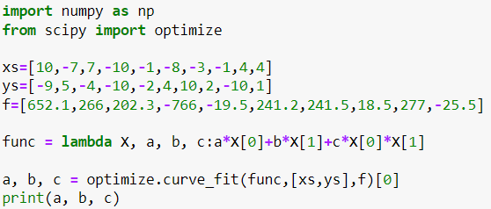
Problem 9
Function variables should be passed using only one variable, the rest is considered as function parameters
Values of several variables can be passed using a nested list
College of Engineering, Sungkyunkwan University

Slide 8

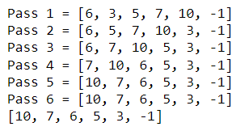
Problem 10
Bubble sort is a simple sorting algorithm, which repeatedly goes through a list of numbers and compares each element with the one after it and swaps them if needed. This passes continue until the elements are sorted and no more swaps are required. There is an example below. Write the function bubble_sort(list_1) which receives a list of numbers and returns the sorted list in the descending order by using the bubble sort algorithm.
Test case
College of Engineering, Sungkyunkwan University

Slide 9
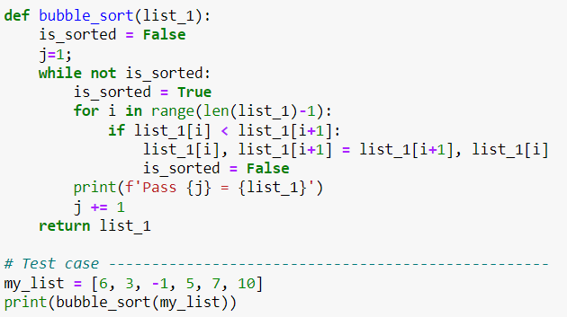
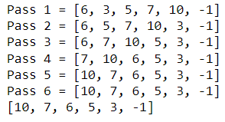
Problem 10
College of Engineering, Sungkyunkwan University

Slide 10
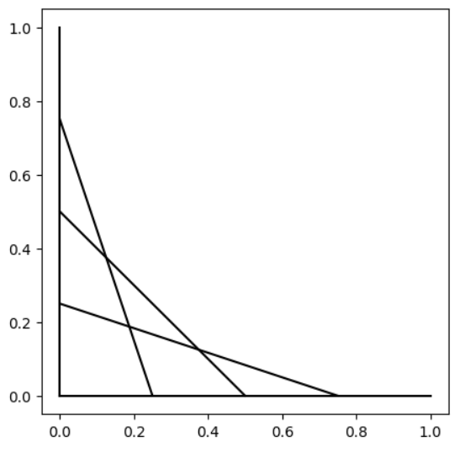
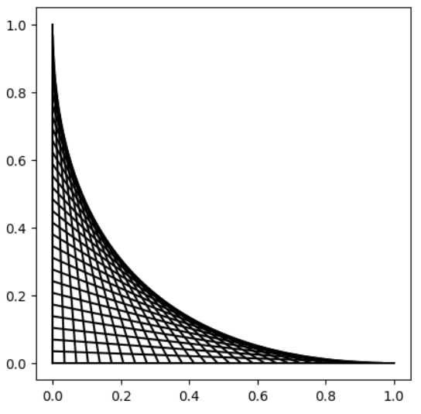


Problem 11
Program a function draw(n) which divides the x- and y-axis from 0 to 1 into n points and draw n lines between the points on these two axis as depicted below.
Test case
$$n=5$$
$$n=30$$
College of Engineering, Sungkyunkwan University

Slide 11
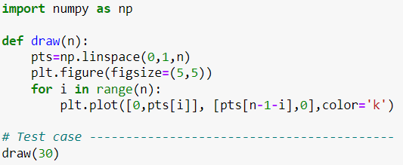
Problem 11
College of Engineering, Sungkyunkwan University

